Slide 1
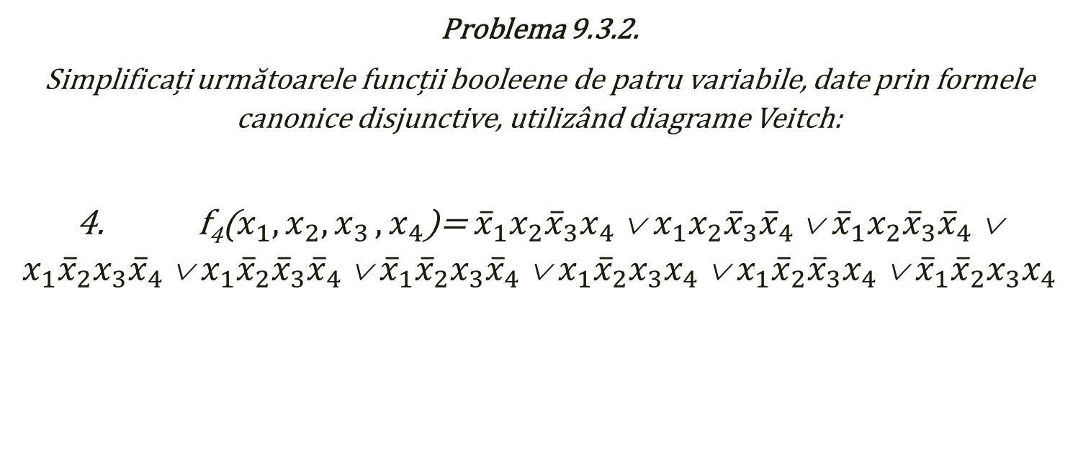
Problema 9.3.2.
Simplificați următoarele funcții booleene de patru variabile, date prin formele canonice disjunctive, utilizând diagrame Veitch:
4. f₄($x_{1},x_{2}{,x}_{3}{,x}_{4}$)= ${\overline{x}}_{1}x_{2}{\overline{x}}_{3}x_{4}$ ∨ $x_{1}x_{2}{\overline{x}}_{3}{\overline{x}}_{4}$ ∨ ${\overline{x}}_{1}x_{2}{\overline{x}}_{3}{\overline{x}}_{4}$ ∨ $x_{1}{\overline{x}}_{2}x_{3}{\overline{x}}_{4}$ ∨ $x_{1}{\overline{x}}_{2}{\overline{x}}_{3}{\overline{x}}_{4}$ ∨ ${\overline{x}}_{1}{\overline{x}}_{2}x_{3}{\overline{x}}_{4}$ ∨ $x_{1}{\overline{x}}_{2}x_{3}x_{4}$ ∨ $x_{1}{\overline{x}}_{2}{\overline{x}}_{3}x_{4}$ ∨ ${\overline{x}}_{1}{\overline{x}}_{2}x_{3}x_{4}$
Fabian-Ionuț Martin

Slide 2
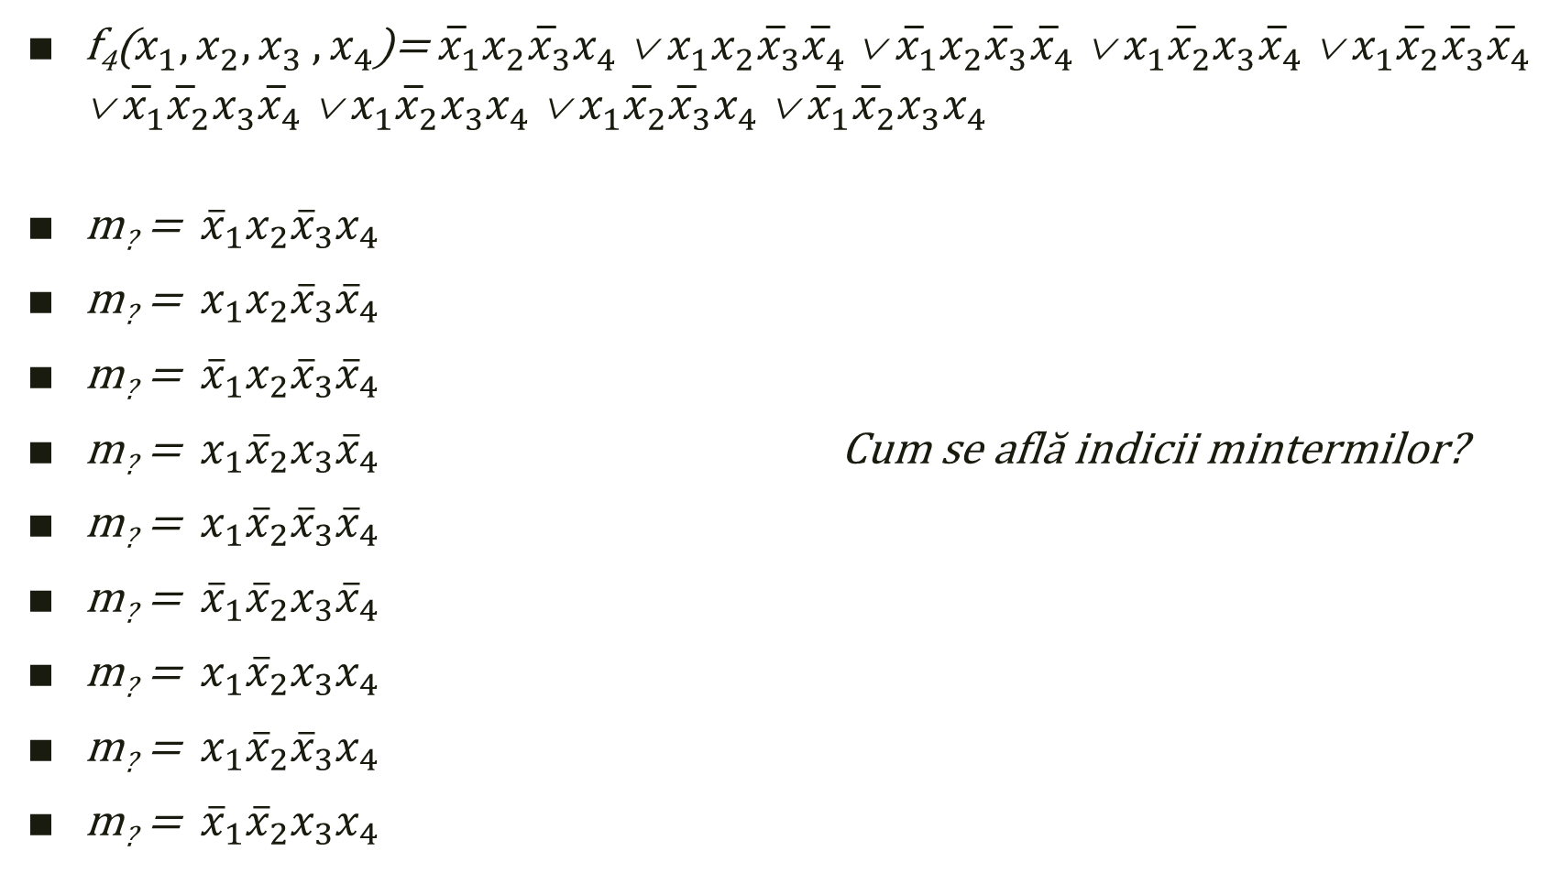
f₄($x_{1},x_{2}{,x}_{3}{,x}_{4}$)= ${\overline{x}}_{1}x_{2}{\overline{x}}_{3}x_{4}$ ∨ $x_{1}x_{2}{\overline{x}}_{3}{\overline{x}}_{4}$ ∨ ${\overline{x}}_{1}x_{2}{\overline{x}}_{3}{\overline{x}}_{4}$ ∨ $x_{1}{\overline{x}}_{2}x_{3}{\overline{x}}_{4}$ ∨ $x_{1}{\overline{x}}_{2}{\overline{x}}_{3}{\overline{x}}_{4}$ ∨ ${\overline{x}}_{1}{\overline{x}}_{2}x_{3}{\overline{x}}_{4}$ ∨ $x_{1}{\overline{x}}_{2}x_{3}x_{4}$ ∨ $x_{1}{\overline{x}}_{2}{\overline{x}}_{3}x_{4}$ ∨ ${\overline{x}}_{1}{\overline{x}}_{2}x_{3}x_{4}$
m? = ${\overline{x}}_{1}x_{2}{\overline{x}}_{3}x_{4}$
m? = $x_{1}x_{2}{\overline{x}}_{3}{\overline{x}}_{4}$
m? = ${\overline{x}}_{1}x_{2}{\overline{x}}_{3}{\overline{x}}_{4}$
m? = $x_{1}{\overline{x}}_{2}x_{3}{\overline{x}}_{4}$ Cum se află indicii mintermilor?
m? = $x_{1}{\overline{x}}_{2}{\overline{x}}_{3}{\overline{x}}_{4}$
m? = ${\overline{x}}_{1}{\overline{x}}_{2}x_{3}{\overline{x}}_{4}$
m? = $x_{1}{\overline{x}}_{2}x_{3}x_{4}$
m? =$x_{1}{\overline{x}}_{2}{\overline{x}}_{3}x_{4}$
m? = ${\overline{x}}_{1}{\overline{x}}_{2}x_{3}x_{4}$

Slide 3
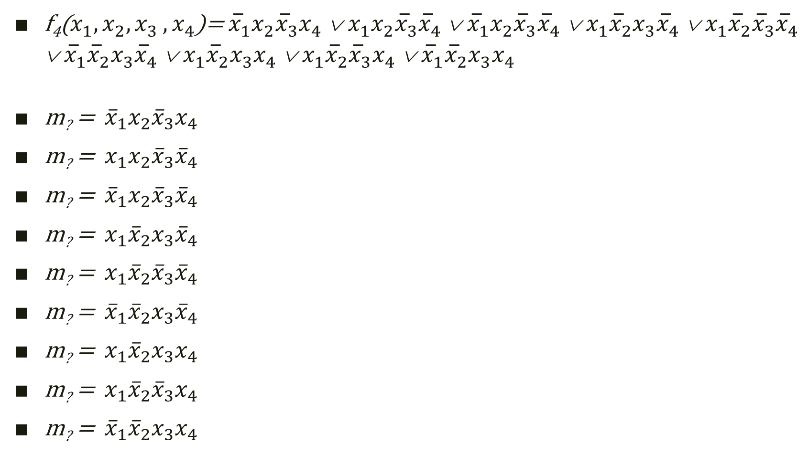
f₄($x_{1},x_{2}{,x}_{3}{,x}_{4}$)= ${\overline{x}}_{1}x_{2}{\overline{x}}_{3}x_{4}$ ∨ $x_{1}x_{2}{\overline{x}}_{3}{\overline{x}}_{4}$ ∨ ${\overline{x}}_{1}x_{2}{\overline{x}}_{3}{\overline{x}}_{4}$ ∨ $x_{1}{\overline{x}}_{2}x_{3}{\overline{x}}_{4}$ ∨ $x_{1}{\overline{x}}_{2}{\overline{x}}_{3}{\overline{x}}_{4}$ ∨ ${\overline{x}}_{1}{\overline{x}}_{2}x_{3}{\overline{x}}_{4}$ ∨ $x_{1}{\overline{x}}_{2}x_{3}x_{4}$ ∨ $x_{1}{\overline{x}}_{2}{\overline{x}}_{3}x_{4}$ ∨ ${\overline{x}}_{1}{\overline{x}}_{2}x_{3}x_{4}$
m? = ${\overline{x}}_{1}x_{2}{\overline{x}}_{3}x_{4}$
m? = $x_{1}x_{2}{\overline{x}}_{3}{\overline{x}}_{4}$
m? = ${\overline{x}}_{1}x_{2}{\overline{x}}_{3}{\overline{x}}_{4}$
m? = $x_{1}{\overline{x}}_{2}x_{3}{\overline{x}}_{4}$
m? = $x_{1}{\overline{x}}_{2}{\overline{x}}_{3}{\overline{x}}_{4}$
m? = ${\overline{x}}_{1}{\overline{x}}_{2}x_{3}{\overline{x}}_{4}$
m? = $x_{1}{\overline{x}}_{2}x_{3}x_{4}$
m? =$x_{1}{\overline{x}}_{2}{\overline{x}}_{3}x_{4}$
m? = ${\overline{x}}_{1}{\overline{x}}_{2}x_{3}x_{4}$
Indicele unui minterm de n variabile este obținut prin conversia în zecimal a numărului binar format cu cifrele ce reprezintă puterile celor n variabile ale expresiei acestuia.

Slide 4
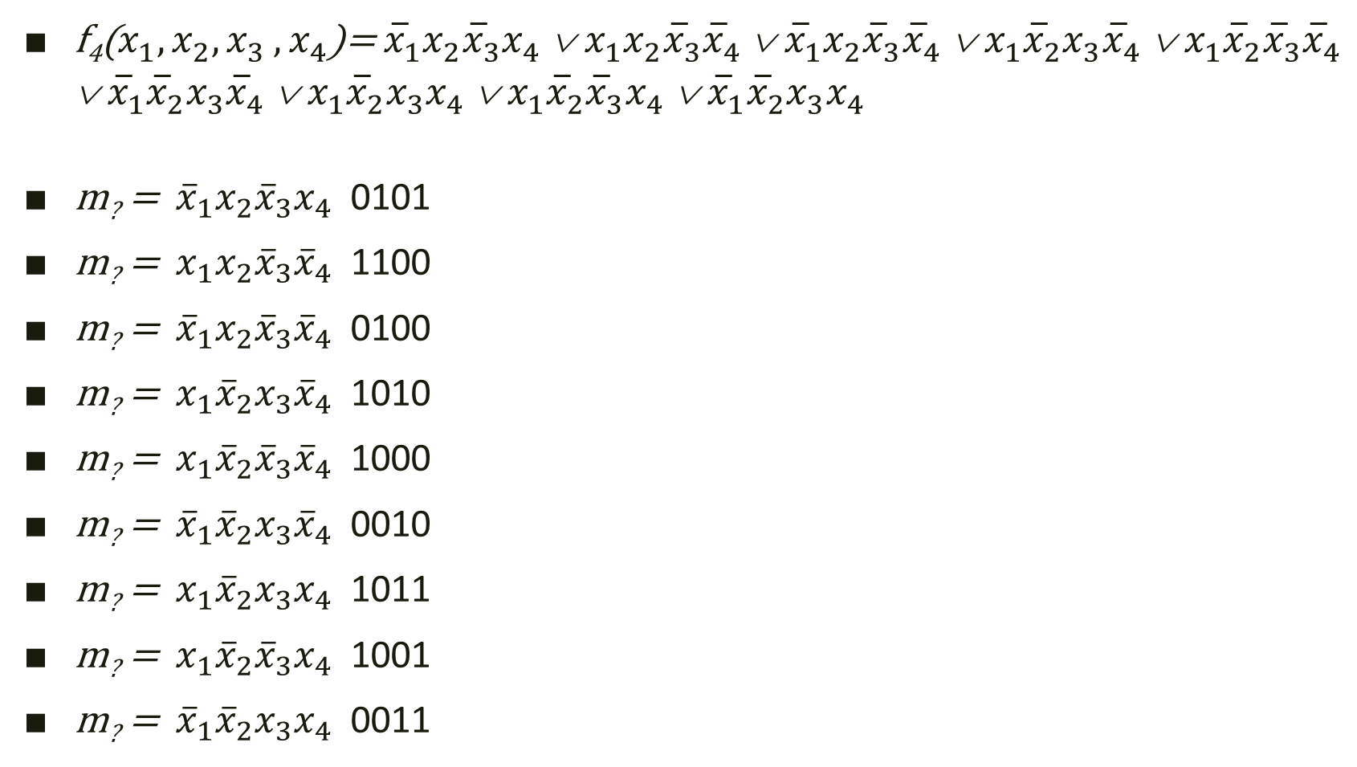
f₄($x_{1},x_{2}{,x}_{3}{,x}_{4}$)= ${\overline{x}}_{1}x_{2}{\overline{x}}_{3}x_{4}$ ∨ $x_{1}x_{2}{\overline{x}}_{3}{\overline{x}}_{4}$ ∨ ${\overline{x}}_{1}x_{2}{\overline{x}}_{3}{\overline{x}}_{4}$ ∨ $x_{1}{\overline{x}}_{2}x_{3}{\overline{x}}_{4}$ ∨ $x_{1}{\overline{x}}_{2}{\overline{x}}_{3}{\overline{x}}_{4}$ ∨ ${\overline{x}}_{1}{\overline{x}}_{2}x_{3}{\overline{x}}_{4}$ ∨ $x_{1}{\overline{x}}_{2}x_{3}x_{4}$ ∨ $x_{1}{\overline{x}}_{2}{\overline{x}}_{3}x_{4}$ ∨ ${\overline{x}}_{1}{\overline{x}}_{2}x_{3}x_{4}$
m? = ${\overline{x}}_{1}x_{2}{\overline{x}}_{3}x_{4}$ 0101
m? = $x_{1}x_{2}{\overline{x}}_{3}{\overline{x}}_{4}$ 1100
m? = ${\overline{x}}_{1}x_{2}{\overline{x}}_{3}{\overline{x}}_{4}$ 0100
m? = $x_{1}{\overline{x}}_{2}x_{3}{\overline{x}}_{4}$ 1010
m? = $x_{1}{\overline{x}}_{2}{\overline{x}}_{3}{\overline{x}}_{4}$ 1000
m? = ${\overline{x}}_{1}{\overline{x}}_{2}x_{3}{\overline{x}}_{4}$ 0010
m? = $x_{1}{\overline{x}}_{2}x_{3}x_{4}$ 1011
m? =$x_{1}{\overline{x}}_{2}{\overline{x}}_{3}x_{4}$ 1001
m? = ${\overline{x}}_{1}{\overline{x}}_{2}x_{3}x_{4}$ 0011

Slide 5
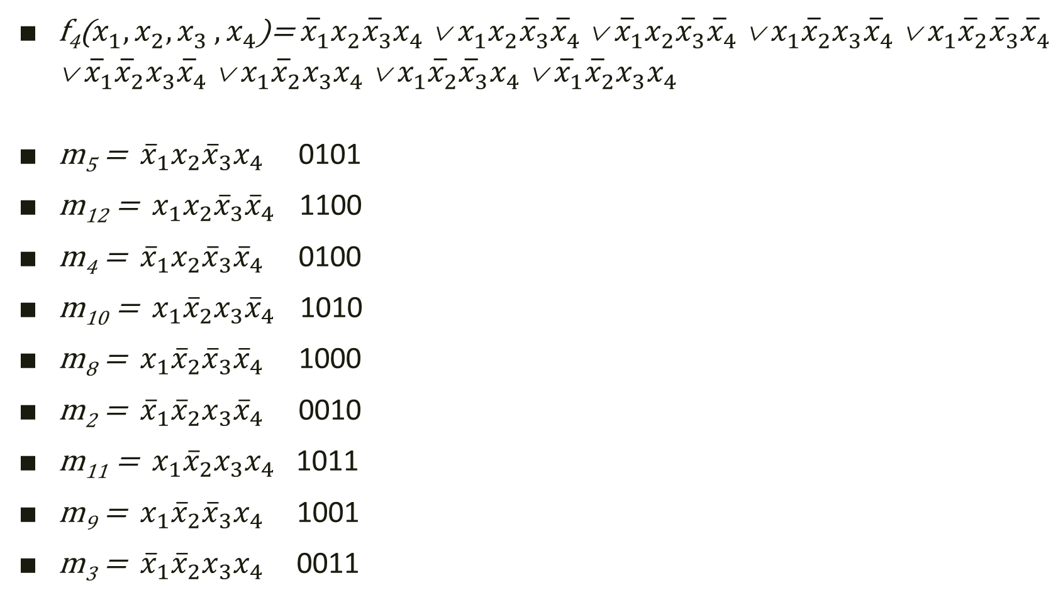
f₄($x_{1},x_{2}{,x}_{3}{,x}_{4}$)= ${\overline{x}}_{1}x_{2}{\overline{x}}_{3}x_{4}$ ∨ $x_{1}x_{2}{\overline{x}}_{3}{\overline{x}}_{4}$ ∨ ${\overline{x}}_{1}x_{2}{\overline{x}}_{3}{\overline{x}}_{4}$ ∨ $x_{1}{\overline{x}}_{2}x_{3}{\overline{x}}_{4}$ ∨ $x_{1}{\overline{x}}_{2}{\overline{x}}_{3}{\overline{x}}_{4}$ ∨ ${\overline{x}}_{1}{\overline{x}}_{2}x_{3}{\overline{x}}_{4}$ ∨ $x_{1}{\overline{x}}_{2}x_{3}x_{4}$ ∨ $x_{1}{\overline{x}}_{2}{\overline{x}}_{3}x_{4}$ ∨ ${\overline{x}}_{1}{\overline{x}}_{2}x_{3}x_{4}$
m₅ = ${\overline{x}}_{1}x_{2}{\overline{x}}_{3}x_{4}$ 0101
m₁₂ = $x_{1}x_{2}{\overline{x}}_{3}{\overline{x}}_{4}$ 1100
m₄ = ${\overline{x}}_{1}x_{2}{\overline{x}}_{3}{\overline{x}}_{4}$ 0100
m₁₀ = $x_{1}{\overline{x}}_{2}x_{3}{\overline{x}}_{4}$ 1010
m₈ = $x_{1}{\overline{x}}_{2}{\overline{x}}_{3}{\overline{x}}_{4}$ 1000
m₂ = ${\overline{x}}_{1}{\overline{x}}_{2}x_{3}{\overline{x}}_{4}$ 0010
m₁₁ = $x_{1}{\overline{x}}_{2}x_{3}x_{4}$ 1011
m₉ =$x_{1}{\overline{x}}_{2}{\overline{x}}_{3}x_{4}$ 1001
m₃ = ${\overline{x}}_{1}{\overline{x}}_{2}x_{3}x_{4}$ 0011
Metoda diagramelor Veitch

Slide 6
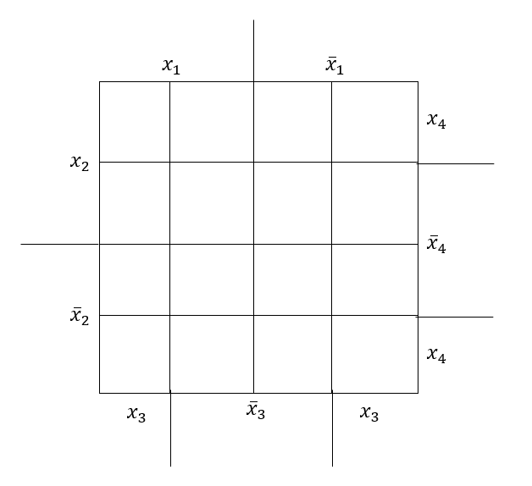
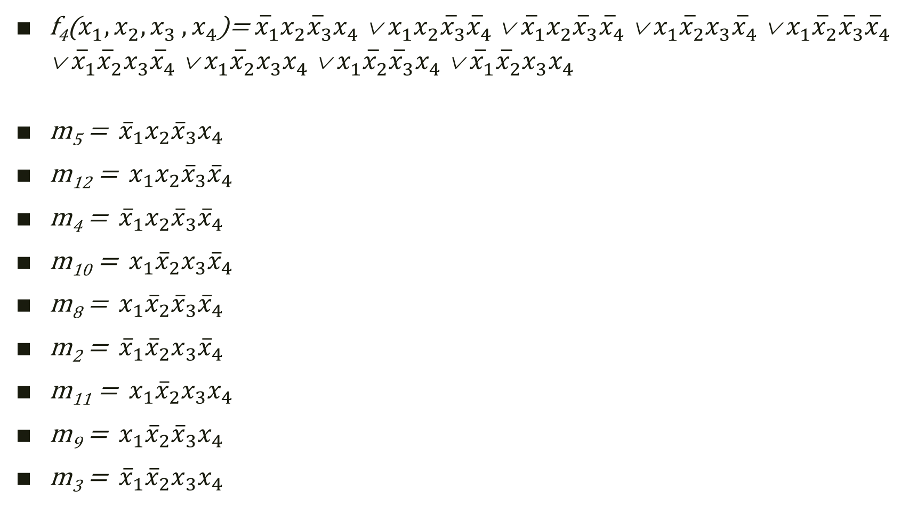
f₄($x_{1},x_{2}{,x}_{3}{,x}_{4}$)= ${\overline{x}}_{1}x_{2}{\overline{x}}_{3}x_{4}$ ∨ $x_{1}x_{2}{\overline{x}}_{3}{\overline{x}}_{4}$ ∨ ${\overline{x}}_{1}x_{2}{\overline{x}}_{3}{\overline{x}}_{4}$ ∨ $x_{1}{\overline{x}}_{2}x_{3}{\overline{x}}_{4}$ ∨ $x_{1}{\overline{x}}_{2}{\overline{x}}_{3}{\overline{x}}_{4}$ ∨ ${\overline{x}}_{1}{\overline{x}}_{2}x_{3}{\overline{x}}_{4}$ ∨ $x_{1}{\overline{x}}_{2}x_{3}x_{4}$ ∨ $x_{1}{\overline{x}}_{2}{\overline{x}}_{3}x_{4}$ ∨ ${\overline{x}}_{1}{\overline{x}}_{2}x_{3}x_{4}$
m₅ = ${\overline{x}}_{1}x_{2}{\overline{x}}_{3}x_{4}$
m₁₂ = $x_{1}x_{2}{\overline{x}}_{3}{\overline{x}}_{4}$
m₄ = ${\overline{x}}_{1}x_{2}{\overline{x}}_{3}{\overline{x}}_{4}$
m₁₀ = $x_{1}{\overline{x}}_{2}x_{3}{\overline{x}}_{4}$
m₈ = $x_{1}{\overline{x}}_{2}{\overline{x}}_{3}{\overline{x}}_{4}$
m₂ = ${\overline{x}}_{1}{\overline{x}}_{2}x_{3}{\overline{x}}_{4}$
m₁₁ = $x_{1}{\overline{x}}_{2}x_{3}x_{4}$
m₉ =$x_{1}{\overline{x}}_{2}{\overline{x}}_{3}x_{4}$
m₃ = ${\overline{x}}_{1}{\overline{x}}_{2}x_{3}x_{4}$
Completarea diagramei:

Slide 7
f₄($x_{1},x_{2}{,x}_{3}{,x}_{4}$)= ${\overline{x}}_{1}x_{2}{\overline{x}}_{3}x_{4}$ ∨ $x_{1}x_{2}{\overline{x}}_{3}{\overline{x}}_{4}$ ∨ ${\overline{x}}_{1}x_{2}{\overline{x}}_{3}{\overline{x}}_{4}$ ∨ $x_{1}{\overline{x}}_{2}x_{3}{\overline{x}}_{4}$ ∨ $x_{1}{\overline{x}}_{2}{\overline{x}}_{3}{\overline{x}}_{4}$ ∨ ${\overline{x}}_{1}{\overline{x}}_{2}x_{3}{\overline{x}}_{4}$ ∨ $x_{1}{\overline{x}}_{2}x_{3}x_{4}$ ∨ $x_{1}{\overline{x}}_{2}{\overline{x}}_{3}x_{4}$ ∨ ${\overline{x}}_{1}{\overline{x}}_{2}x_{3}x_{4}$
m₅ = ${\overline{x}}_{1}x_{2}{\overline{x}}_{3}x_{4}$
m₁₂ = $x_{1}x_{2}{\overline{x}}_{3}{\overline{x}}_{4}$
m₄ = ${\overline{x}}_{1}x_{2}{\overline{x}}_{3}{\overline{x}}_{4}$
m₁₀ = $x_{1}{\overline{x}}_{2}x_{3}{\overline{x}}_{4}$
m₈ = $x_{1}{\overline{x}}_{2}{\overline{x}}_{3}{\overline{x}}_{4}$
m₂ = ${\overline{x}}_{1}{\overline{x}}_{2}x_{3}{\overline{x}}_{4}$
m₁₁ = $x_{1}{\overline{x}}_{2}x_{3}x_{4}$
m₉ =$x_{1}{\overline{x}}_{2}{\overline{x}}_{3}x_{4}$
m₃ = ${\overline{x}}_{1}{\overline{x}}_{2}x_{3}x_{4}$
m₅

Slide 8
f₄($x_{1},x_{2}{,x}_{3}{,x}_{4}$)= ${\overline{x}}_{1}x_{2}{\overline{x}}_{3}x_{4}$ ∨ $x_{1}x_{2}{\overline{x}}_{3}{\overline{x}}_{4}$ ∨ ${\overline{x}}_{1}x_{2}{\overline{x}}_{3}{\overline{x}}_{4}$ ∨ $x_{1}{\overline{x}}_{2}x_{3}{\overline{x}}_{4}$ ∨ $x_{1}{\overline{x}}_{2}{\overline{x}}_{3}{\overline{x}}_{4}$ ∨ ${\overline{x}}_{1}{\overline{x}}_{2}x_{3}{\overline{x}}_{4}$ ∨ $x_{1}{\overline{x}}_{2}x_{3}x_{4}$ ∨ $x_{1}{\overline{x}}_{2}{\overline{x}}_{3}x_{4}$ ∨ ${\overline{x}}_{1}{\overline{x}}_{2}x_{3}x_{4}$
m₅ = ${\overline{x}}_{1}x_{2}{\overline{x}}_{3}x_{4}$
m₁₂ = $x_{1}x_{2}{\overline{x}}_{3}{\overline{x}}_{4}$
m₄ = ${\overline{x}}_{1}x_{2}{\overline{x}}_{3}{\overline{x}}_{4}$
m₁₀ = $x_{1}{\overline{x}}_{2}x_{3}{\overline{x}}_{4}$
m₈ = $x_{1}{\overline{x}}_{2}{\overline{x}}_{3}{\overline{x}}_{4}$
m₂ = ${\overline{x}}_{1}{\overline{x}}_{2}x_{3}{\overline{x}}_{4}$
m₁₁ = $x_{1}{\overline{x}}_{2}x_{3}x_{4}$
m₉ =$x_{1}{\overline{x}}_{2}{\overline{x}}_{3}x_{4}$
m₃ = ${\overline{x}}_{1}{\overline{x}}_{2}x_{3}x_{4}$
m₅
m₁₂

Slide 9
f₄($x_{1},x_{2}{,x}_{3}{,x}_{4}$)= ${\overline{x}}_{1}x_{2}{\overline{x}}_{3}x_{4}$ ∨ $x_{1}x_{2}{\overline{x}}_{3}{\overline{x}}_{4}$ ∨ ${\overline{x}}_{1}x_{2}{\overline{x}}_{3}{\overline{x}}_{4}$ ∨ $x_{1}{\overline{x}}_{2}x_{3}{\overline{x}}_{4}$ ∨ $x_{1}{\overline{x}}_{2}{\overline{x}}_{3}{\overline{x}}_{4}$ ∨ ${\overline{x}}_{1}{\overline{x}}_{2}x_{3}{\overline{x}}_{4}$ ∨ $x_{1}{\overline{x}}_{2}x_{3}x_{4}$ ∨ $x_{1}{\overline{x}}_{2}{\overline{x}}_{3}x_{4}$ ∨ ${\overline{x}}_{1}{\overline{x}}_{2}x_{3}x_{4}$
m₅ = ${\overline{x}}_{1}x_{2}{\overline{x}}_{3}x_{4}$
m₁₂ = $x_{1}x_{2}{\overline{x}}_{3}{\overline{x}}_{4}$
m₄ = ${\overline{x}}_{1}x_{2}{\overline{x}}_{3}{\overline{x}}_{4}$
m₁₀ = $x_{1}{\overline{x}}_{2}x_{3}{\overline{x}}_{4}$
m₈ = $x_{1}{\overline{x}}_{2}{\overline{x}}_{3}{\overline{x}}_{4}$
m₂ = ${\overline{x}}_{1}{\overline{x}}_{2}x_{3}{\overline{x}}_{4}$
m₁₁ = $x_{1}{\overline{x}}_{2}x_{3}x_{4}$
m₉ =$x_{1}{\overline{x}}_{2}{\overline{x}}_{3}x_{4}$
m₃ = ${\overline{x}}_{1}{\overline{x}}_{2}x_{3}x_{4}$
m₅
m₁₂
m₄

Slide 10
f₄($x_{1},x_{2}{,x}_{3}{,x}_{4}$)= ${\overline{x}}_{1}x_{2}{\overline{x}}_{3}x_{4}$ ∨ $x_{1}x_{2}{\overline{x}}_{3}{\overline{x}}_{4}$ ∨ ${\overline{x}}_{1}x_{2}{\overline{x}}_{3}{\overline{x}}_{4}$ ∨ $x_{1}{\overline{x}}_{2}x_{3}{\overline{x}}_{4}$ ∨ $x_{1}{\overline{x}}_{2}{\overline{x}}_{3}{\overline{x}}_{4}$ ∨ ${\overline{x}}_{1}{\overline{x}}_{2}x_{3}{\overline{x}}_{4}$ ∨ $x_{1}{\overline{x}}_{2}x_{3}x_{4}$ ∨ $x_{1}{\overline{x}}_{2}{\overline{x}}_{3}x_{4}$ ∨ ${\overline{x}}_{1}{\overline{x}}_{2}x_{3}x_{4}$
m₅ = ${\overline{x}}_{1}x_{2}{\overline{x}}_{3}x_{4}$
m₁₂ = $x_{1}x_{2}{\overline{x}}_{3}{\overline{x}}_{4}$
m₄ = ${\overline{x}}_{1}x_{2}{\overline{x}}_{3}{\overline{x}}_{4}$
m₁₀ = $x_{1}{\overline{x}}_{2}x_{3}{\overline{x}}_{4}$
m₈ = $x_{1}{\overline{x}}_{2}{\overline{x}}_{3}{\overline{x}}_{4}$
m₂ = ${\overline{x}}_{1}{\overline{x}}_{2}x_{3}{\overline{x}}_{4}$
m₁₁ = $x_{1}{\overline{x}}_{2}x_{3}x_{4}$
m₉ =$x_{1}{\overline{x}}_{2}{\overline{x}}_{3}x_{4}$
m₃ = ${\overline{x}}_{1}{\overline{x}}_{2}x_{3}x_{4}$
m₅
m₁₂
m₄
m₁₀

Slide 11
f₄($x_{1},x_{2}{,x}_{3}{,x}_{4}$)= ${\overline{x}}_{1}x_{2}{\overline{x}}_{3}x_{4}$ ∨ $x_{1}x_{2}{\overline{x}}_{3}{\overline{x}}_{4}$ ∨ ${\overline{x}}_{1}x_{2}{\overline{x}}_{3}{\overline{x}}_{4}$ ∨ $x_{1}{\overline{x}}_{2}x_{3}{\overline{x}}_{4}$ ∨ $x_{1}{\overline{x}}_{2}{\overline{x}}_{3}{\overline{x}}_{4}$ ∨ ${\overline{x}}_{1}{\overline{x}}_{2}x_{3}{\overline{x}}_{4}$ ∨ $x_{1}{\overline{x}}_{2}x_{3}x_{4}$ ∨ $x_{1}{\overline{x}}_{2}{\overline{x}}_{3}x_{4}$ ∨ ${\overline{x}}_{1}{\overline{x}}_{2}x_{3}x_{4}$
m₅ = ${\overline{x}}_{1}x_{2}{\overline{x}}_{3}x_{4}$
m₁₂ = $x_{1}x_{2}{\overline{x}}_{3}{\overline{x}}_{4}$
m₄ = ${\overline{x}}_{1}x_{2}{\overline{x}}_{3}{\overline{x}}_{4}$
m₁₀ = $x_{1}{\overline{x}}_{2}x_{3}{\overline{x}}_{4}$
m₈ = $x_{1}{\overline{x}}_{2}{\overline{x}}_{3}{\overline{x}}_{4}$
m₂ = ${\overline{x}}_{1}{\overline{x}}_{2}x_{3}{\overline{x}}_{4}$
m₁₁ = $x_{1}{\overline{x}}_{2}x_{3}x_{4}$
m₉ =$x_{1}{\overline{x}}_{2}{\overline{x}}_{3}x_{4}$
m₃ = ${\overline{x}}_{1}{\overline{x}}_{2}x_{3}x_{4}$
m₅
m₁₂
m₄
m₁₀
m₈

Slide 12
f₄($x_{1},x_{2}{,x}_{3}{,x}_{4}$)= ${\overline{x}}_{1}x_{2}{\overline{x}}_{3}x_{4}$ ∨ $x_{1}x_{2}{\overline{x}}_{3}{\overline{x}}_{4}$ ∨ ${\overline{x}}_{1}x_{2}{\overline{x}}_{3}{\overline{x}}_{4}$ ∨ $x_{1}{\overline{x}}_{2}x_{3}{\overline{x}}_{4}$ ∨ $x_{1}{\overline{x}}_{2}{\overline{x}}_{3}{\overline{x}}_{4}$ ∨ ${\overline{x}}_{1}{\overline{x}}_{2}x_{3}{\overline{x}}_{4}$ ∨ $x_{1}{\overline{x}}_{2}x_{3}x_{4}$ ∨ $x_{1}{\overline{x}}_{2}{\overline{x}}_{3}x_{4}$ ∨ ${\overline{x}}_{1}{\overline{x}}_{2}x_{3}x_{4}$
m₅ = ${\overline{x}}_{1}x_{2}{\overline{x}}_{3}x_{4}$
m₁₂ = $x_{1}x_{2}{\overline{x}}_{3}{\overline{x}}_{4}$
m₄ = ${\overline{x}}_{1}x_{2}{\overline{x}}_{3}{\overline{x}}_{4}$
m₁₀ = $x_{1}{\overline{x}}_{2}x_{3}{\overline{x}}_{4}$
m₈ = $x_{1}{\overline{x}}_{2}{\overline{x}}_{3}{\overline{x}}_{4}$
m₂ = ${\overline{x}}_{1}{\overline{x}}_{2}x_{3}{\overline{x}}_{4}$
m₁₁ = $x_{1}{\overline{x}}_{2}x_{3}x_{4}$
m₉ =$x_{1}{\overline{x}}_{2}{\overline{x}}_{3}x_{4}$
m₃ = ${\overline{x}}_{1}{\overline{x}}_{2}x_{3}x_{4}$
m₅
m₁₂
m₄
m₁₀
m₈
m₂

Slide 13
f₄($x_{1},x_{2}{,x}_{3}{,x}_{4}$)= ${\overline{x}}_{1}x_{2}{\overline{x}}_{3}x_{4}$ ∨ $x_{1}x_{2}{\overline{x}}_{3}{\overline{x}}_{4}$ ∨ ${\overline{x}}_{1}x_{2}{\overline{x}}_{3}{\overline{x}}_{4}$ ∨ $x_{1}{\overline{x}}_{2}x_{3}{\overline{x}}_{4}$ ∨ $x_{1}{\overline{x}}_{2}{\overline{x}}_{3}{\overline{x}}_{4}$ ∨ ${\overline{x}}_{1}{\overline{x}}_{2}x_{3}{\overline{x}}_{4}$ ∨ $x_{1}{\overline{x}}_{2}x_{3}x_{4}$ ∨ $x_{1}{\overline{x}}_{2}{\overline{x}}_{3}x_{4}$ ∨ ${\overline{x}}_{1}{\overline{x}}_{2}x_{3}x_{4}$
m₅ = ${\overline{x}}_{1}x_{2}{\overline{x}}_{3}x_{4}$
m₁₂ = $x_{1}x_{2}{\overline{x}}_{3}{\overline{x}}_{4}$
m₄ = ${\overline{x}}_{1}x_{2}{\overline{x}}_{3}{\overline{x}}_{4}$
m₁₀ = $x_{1}{\overline{x}}_{2}x_{3}{\overline{x}}_{4}$
m₈ = $x_{1}{\overline{x}}_{2}{\overline{x}}_{3}{\overline{x}}_{4}$
m₂ = ${\overline{x}}_{1}{\overline{x}}_{2}x_{3}{\overline{x}}_{4}$
m₁₁ = $x_{1}{\overline{x}}_{2}x_{3}x_{4}$
m₉ =$x_{1}{\overline{x}}_{2}{\overline{x}}_{3}x_{4}$
m₃ = ${\overline{x}}_{1}{\overline{x}}_{2}x_{3}x_{4}$
m₅
m₁₂
m₄
m₁₀
m₈
m₂
m₁₁

Slide 14
f₄($x_{1},x_{2}{,x}_{3}{,x}_{4}$)= ${\overline{x}}_{1}x_{2}{\overline{x}}_{3}x_{4}$ ∨ $x_{1}x_{2}{\overline{x}}_{3}{\overline{x}}_{4}$ ∨ ${\overline{x}}_{1}x_{2}{\overline{x}}_{3}{\overline{x}}_{4}$ ∨ $x_{1}{\overline{x}}_{2}x_{3}{\overline{x}}_{4}$ ∨ $x_{1}{\overline{x}}_{2}{\overline{x}}_{3}{\overline{x}}_{4}$ ∨ ${\overline{x}}_{1}{\overline{x}}_{2}x_{3}{\overline{x}}_{4}$ ∨ $x_{1}{\overline{x}}_{2}x_{3}x_{4}$ ∨ $x_{1}{\overline{x}}_{2}{\overline{x}}_{3}x_{4}$ ∨ ${\overline{x}}_{1}{\overline{x}}_{2}x_{3}x_{4}$
m₅ = ${\overline{x}}_{1}x_{2}{\overline{x}}_{3}x_{4}$
m₁₂ = $x_{1}x_{2}{\overline{x}}_{3}{\overline{x}}_{4}$
m₄ = ${\overline{x}}_{1}x_{2}{\overline{x}}_{3}{\overline{x}}_{4}$
m₁₀ = $x_{1}{\overline{x}}_{2}x_{3}{\overline{x}}_{4}$
m₈ = $x_{1}{\overline{x}}_{2}{\overline{x}}_{3}{\overline{x}}_{4}$
m₂ = ${\overline{x}}_{1}{\overline{x}}_{2}x_{3}{\overline{x}}_{4}$
m₁₁ = $x_{1}{\overline{x}}_{2}x_{3}x_{4}$
m₉ =$x_{1}{\overline{x}}_{2}{\overline{x}}_{3}x_{4}$
m₃ = ${\overline{x}}_{1}{\overline{x}}_{2}x_{3}x_{4}$
m₅
m₁₂
m₄
m₁₀
m₈
m₂
m₁₁
m₉

Slide 15
f₄($x_{1},x_{2}{,x}_{3}{,x}_{4}$)= ${\overline{x}}_{1}x_{2}{\overline{x}}_{3}x_{4}$ ∨ $x_{1}x_{2}{\overline{x}}_{3}{\overline{x}}_{4}$ ∨ ${\overline{x}}_{1}x_{2}{\overline{x}}_{3}{\overline{x}}_{4}$ ∨ $x_{1}{\overline{x}}_{2}x_{3}{\overline{x}}_{4}$ ∨ $x_{1}{\overline{x}}_{2}{\overline{x}}_{3}{\overline{x}}_{4}$ ∨ ${\overline{x}}_{1}{\overline{x}}_{2}x_{3}{\overline{x}}_{4}$ ∨ $x_{1}{\overline{x}}_{2}x_{3}x_{4}$ ∨ $x_{1}{\overline{x}}_{2}{\overline{x}}_{3}x_{4}$ ∨ ${\overline{x}}_{1}{\overline{x}}_{2}x_{3}x_{4}$
m₅ = ${\overline{x}}_{1}x_{2}{\overline{x}}_{3}x_{4}$
m₁₂ = $x_{1}x_{2}{\overline{x}}_{3}{\overline{x}}_{4}$
m₄ = ${\overline{x}}_{1}x_{2}{\overline{x}}_{3}{\overline{x}}_{4}$
m₁₀ = $x_{1}{\overline{x}}_{2}x_{3}{\overline{x}}_{4}$
m₈ = $x_{1}{\overline{x}}_{2}{\overline{x}}_{3}{\overline{x}}_{4}$
m₂ = ${\overline{x}}_{1}{\overline{x}}_{2}x_{3}{\overline{x}}_{4}$
m₁₁ = $x_{1}{\overline{x}}_{2}x_{3}x_{4}$
m₉ =$x_{1}{\overline{x}}_{2}{\overline{x}}_{3}x_{4}$
m₃ = ${\overline{x}}_{1}{\overline{x}}_{2}x_{3}x_{4}$
m₅
m₁₂
m₄
m₁₀
m₈
m₂
m₁₁
m₉
m₃

Slide 16
f₄($x_{1},x_{2}{,x}_{3}{,x}_{4}$)= ${\overline{x}}_{1}x_{2}{\overline{x}}_{3}x_{4}$ ∨ $x_{1}x_{2}{\overline{x}}_{3}{\overline{x}}_{4}$ ∨ ${\overline{x}}_{1}x_{2}{\overline{x}}_{3}{\overline{x}}_{4}$ ∨ $x_{1}{\overline{x}}_{2}x_{3}{\overline{x}}_{4}$ ∨ $x_{1}{\overline{x}}_{2}{\overline{x}}_{3}{\overline{x}}_{4}$ ∨ ${\overline{x}}_{1}{\overline{x}}_{2}x_{3}{\overline{x}}_{4}$ ∨ $x_{1}{\overline{x}}_{2}x_{3}x_{4}$ ∨ $x_{1}{\overline{x}}_{2}{\overline{x}}_{3}x_{4}$ ∨ ${\overline{x}}_{1}{\overline{x}}_{2}x_{3}x_{4}$
m₅ = ${\overline{x}}_{1}x_{2}{\overline{x}}_{3}x_{4}$
m₁₂ = $x_{1}x_{2}{\overline{x}}_{3}{\overline{x}}_{4}$
m₄ = ${\overline{x}}_{1}x_{2}{\overline{x}}_{3}{\overline{x}}_{4}$
m₁₀ = $x_{1}{\overline{x}}_{2}x_{3}{\overline{x}}_{4}$
m₈ = $x_{1}{\overline{x}}_{2}{\overline{x}}_{3}{\overline{x}}_{4}$
m₂ = ${\overline{x}}_{1}{\overline{x}}_{2}x_{3}{\overline{x}}_{4}$
m₁₁ = $x_{1}{\overline{x}}_{2}x_{3}x_{4}$
m₉ =$x_{1}{\overline{x}}_{2}{\overline{x}}_{3}x_{4}$
m₃ = ${\overline{x}}_{1}{\overline{x}}_{2}x_{3}x_{4}$
Factorizarea...
m₅
m₁₂
m₄
m₁₀
m₈
m₂
m₁₁
m₉
m₃

Slide 17
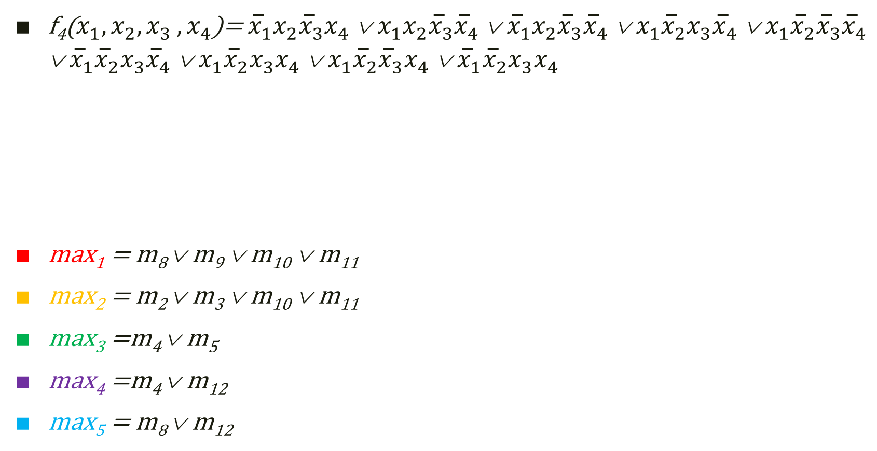

f₄($x_{1},x_{2}{,x}_{3}{,x}_{4}$)= ${\overline{x}}_{1}x_{2}{\overline{x}}_{3}x_{4}$ ∨ $x_{1}x_{2}{\overline{x}}_{3}{\overline{x}}_{4}$ ∨ ${\overline{x}}_{1}x_{2}{\overline{x}}_{3}{\overline{x}}_{4}$ ∨ $x_{1}{\overline{x}}_{2}x_{3}{\overline{x}}_{4}$ ∨ $x_{1}{\overline{x}}_{2}{\overline{x}}_{3}{\overline{x}}_{4}$ ∨ ${\overline{x}}_{1}{\overline{x}}_{2}x_{3}{\overline{x}}_{4}$ ∨ $x_{1}{\overline{x}}_{2}x_{3}x_{4}$ ∨ $x_{1}{\overline{x}}_{2}{\overline{x}}_{3}x_{4}$ ∨ ${\overline{x}}_{1}{\overline{x}}_{2}x_{3}x_{4}$
max₁ = m₈ ∨ m₉ ∨ m₁₀ ∨ m₁₁
max₂ = m₂ ∨ m₃ ∨ m₁₀ ∨ m₁₁
max₃ =m₄ ∨ m₅
max₄ =m₄ ∨ m₁₂
max₅ = m₈ ∨ m₁₂
Se grupează $2^{k}$, k $∈$N mintermi adiacenți
m₅
m₁₂
m₄
m₁₀
m₈
m₂
m₁₁
m₉
m₃

Slide 18

f₄($x_{1},x_{2}{,x}_{3}{,x}_{4}$)= ${\overline{x}}_{1}x_{2}{\overline{x}}_{3}x_{4}$ ∨ $x_{1}x_{2}{\overline{x}}_{3}{\overline{x}}_{4}$ ∨ ${\overline{x}}_{1}x_{2}{\overline{x}}_{3}{\overline{x}}_{4}$ ∨ $x_{1}{\overline{x}}_{2}x_{3}{\overline{x}}_{4}$ ∨ $x_{1}{\overline{x}}_{2}{\overline{x}}_{3}{\overline{x}}_{4}$ ∨ ${\overline{x}}_{1}{\overline{x}}_{2}x_{3}{\overline{x}}_{4}$ ∨ $x_{1}{\overline{x}}_{2}x_{3}x_{4}$ ∨ $x_{1}{\overline{x}}_{2}{\overline{x}}_{3}x_{4}$ ∨ ${\overline{x}}_{1}{\overline{x}}_{2}x_{3}x_{4}$
m₈ = $x_{1}{\overline{x}}_{2}{\overline{x}}_{3}{\overline{x}}_{4}$
m₉ =$x_{1}{\overline{x}}_{2}{\overline{x}}_{3}x_{4}$
m₁₀ = $x_{1}{\overline{x}}_{2}x_{3}{\overline{x}}_{4}$
m₁₁ = $x_{1}{\overline{x}}_{2}x_{3}x_{4}$
max₁ = m₈ ∨ m₉ ∨ m₁₀ ∨ m₁₁
max₁ = $?$
m₅
m₁₂
m₄
m₁₀
m₈
m₂
m₁₁
m₉
m₃

Slide 19

f₄($x_{1},x_{2}{,x}_{3}{,x}_{4}$)= ${\overline{x}}_{1}x_{2}{\overline{x}}_{3}x_{4}$ ∨ $x_{1}x_{2}{\overline{x}}_{3}{\overline{x}}_{4}$ ∨ ${\overline{x}}_{1}x_{2}{\overline{x}}_{3}{\overline{x}}_{4}$ ∨ $x_{1}{\overline{x}}_{2}x_{3}{\overline{x}}_{4}$ ∨ $x_{1}{\overline{x}}_{2}{\overline{x}}_{3}{\overline{x}}_{4}$ ∨ ${\overline{x}}_{1}{\overline{x}}_{2}x_{3}{\overline{x}}_{4}$ ∨ $x_{1}{\overline{x}}_{2}x_{3}x_{4}$ ∨ $x_{1}{\overline{x}}_{2}{\overline{x}}_{3}x_{4}$ ∨ ${\overline{x}}_{1}{\overline{x}}_{2}x_{3}x_{4}$
m₈ = $x_{1}{\overline{x}}_{2}{\overline{x}}_{3}{\overline{x}}_{4}$
m₉ =$x_{1}{\overline{x}}_{2}{\overline{x}}_{3}x_{4}$
m₁₀ = $x_{1}{\overline{x}}_{2}x_{3}{\overline{x}}_{4}$
m₁₁ = $x_{1}{\overline{x}}_{2}x_{3}x_{4}$
max₁ = m₈ ∨ m₉ ∨ m₁₀ ∨ m₁₁
max₁ = $x_{1}{\overline{x}}_{2}$
m₅
m₁₂
m₄
m₁₀
m₈
m₂
m₁₁
m₉
m₃

Slide 20

f₄($x_{1},x_{2}{,x}_{3}{,x}_{4}$)= ${\overline{x}}_{1}x_{2}{\overline{x}}_{3}x_{4}$ ∨ $x_{1}x_{2}{\overline{x}}_{3}{\overline{x}}_{4}$ ∨ ${\overline{x}}_{1}x_{2}{\overline{x}}_{3}{\overline{x}}_{4}$ ∨ $x_{1}{\overline{x}}_{2}x_{3}{\overline{x}}_{4}$ ∨ $x_{1}{\overline{x}}_{2}{\overline{x}}_{3}{\overline{x}}_{4}$ ∨ ${\overline{x}}_{1}{\overline{x}}_{2}x_{3}{\overline{x}}_{4}$ ∨ $x_{1}{\overline{x}}_{2}x_{3}x_{4}$ ∨ $x_{1}{\overline{x}}_{2}{\overline{x}}_{3}x_{4}$ ∨ ${\overline{x}}_{1}{\overline{x}}_{2}x_{3}x_{4}$
m₂ = ${\overline{x}}_{1}{\overline{x}}_{2}x_{3}{\overline{x}}_{4}$
m₃ = ${\overline{x}}_{1}{\overline{x}}_{2}x_{3}x_{4}$
m₁₀ = $x_{1}{\overline{x}}_{2}x_{3}{\overline{x}}_{4}$
m₁₁ = $x_{1}{\overline{x}}_{2}x_{3}x_{4}$
max₂ = m₂ ∨ m₃ ∨ m₁₀ ∨ m₁₁
max₂ =$?$
m₅
m₁₂
m₄
m₁₀
m₈
m₂
m₁₁
m₉
m₃

Slide 21

f₄($x_{1},x_{2}{,x}_{3}{,x}_{4}$)= ${\overline{x}}_{1}x_{2}{\overline{x}}_{3}x_{4}$ ∨ $x_{1}x_{2}{\overline{x}}_{3}{\overline{x}}_{4}$ ∨ ${\overline{x}}_{1}x_{2}{\overline{x}}_{3}{\overline{x}}_{4}$ ∨ $x_{1}{\overline{x}}_{2}x_{3}{\overline{x}}_{4}$ ∨ $x_{1}{\overline{x}}_{2}{\overline{x}}_{3}{\overline{x}}_{4}$ ∨ ${\overline{x}}_{1}{\overline{x}}_{2}x_{3}{\overline{x}}_{4}$ ∨ $x_{1}{\overline{x}}_{2}x_{3}x_{4}$ ∨ $x_{1}{\overline{x}}_{2}{\overline{x}}_{3}x_{4}$ ∨ ${\overline{x}}_{1}{\overline{x}}_{2}x_{3}x_{4}$
m₂ = ${\overline{x}}_{1}{\overline{x}}_{2}x_{3}{\overline{x}}_{4}$
m₃ = ${\overline{x}}_{1}{\overline{x}}_{2}x_{3}x_{4}$
m₁₀ = $x_{1}{\overline{x}}_{2}x_{3}{\overline{x}}_{4}$
m₁₁ = $x_{1}{\overline{x}}_{2}x_{3}x_{4}$
max₂ = m₂ ∨ m₃ ∨ m₁₀ ∨ m₁₁
max₂ = ${\overline{x}}_{2}x_{3}$
m₅
m₁₂
m₄
m₁₀
m₈
m₂
m₁₁
m₉
m₃

Slide 22

f₄($x_{1},x_{2}{,x}_{3}{,x}_{4}$)= ${\overline{x}}_{1}x_{2}{\overline{x}}_{3}x_{4}$ ∨ $x_{1}x_{2}{\overline{x}}_{3}{\overline{x}}_{4}$ ∨ ${\overline{x}}_{1}x_{2}{\overline{x}}_{3}{\overline{x}}_{4}$ ∨ $x_{1}{\overline{x}}_{2}x_{3}{\overline{x}}_{4}$ ∨ $x_{1}{\overline{x}}_{2}{\overline{x}}_{3}{\overline{x}}_{4}$ ∨ ${\overline{x}}_{1}{\overline{x}}_{2}x_{3}{\overline{x}}_{4}$ ∨ $x_{1}{\overline{x}}_{2}x_{3}x_{4}$ ∨ $x_{1}{\overline{x}}_{2}{\overline{x}}_{3}x_{4}$ ∨ ${\overline{x}}_{1}{\overline{x}}_{2}x_{3}x_{4}$
m₄ = ${\overline{x}}_{1}x_{2}{\overline{x}}_{3}{\overline{x}}_{4}$
m₅ = ${\overline{x}}_{1}x_{2}{\overline{x}}_{3}x_{4}$
max₃ =m₄ ∨ m₅
max₃ = $?$
m₅
m₁₂
m₄
m₁₀
m₈
m₂
m₁₁
m₉
m₃

Slide 23

f₄($x_{1},x_{2}{,x}_{3}{,x}_{4}$)= ${\overline{x}}_{1}x_{2}{\overline{x}}_{3}x_{4}$ ∨ $x_{1}x_{2}{\overline{x}}_{3}{\overline{x}}_{4}$ ∨ ${\overline{x}}_{1}x_{2}{\overline{x}}_{3}{\overline{x}}_{4}$ ∨ $x_{1}{\overline{x}}_{2}x_{3}{\overline{x}}_{4}$ ∨ $x_{1}{\overline{x}}_{2}{\overline{x}}_{3}{\overline{x}}_{4}$ ∨ ${\overline{x}}_{1}{\overline{x}}_{2}x_{3}{\overline{x}}_{4}$ ∨ $x_{1}{\overline{x}}_{2}x_{3}x_{4}$ ∨ $x_{1}{\overline{x}}_{2}{\overline{x}}_{3}x_{4}$ ∨ ${\overline{x}}_{1}{\overline{x}}_{2}x_{3}x_{4}$
m₄ = ${\overline{x}}_{1}x_{2}{\overline{x}}_{3}{\overline{x}}_{4}$
m₅ = ${\overline{x}}_{1}x_{2}{\overline{x}}_{3}x_{4}$
max₃ =m₄ ∨ m₅
max₃ = ${\overline{x}}_{1}x_{2}{\overline{x}}_{3}$
m₅
m₁₂
m₄
m₁₀
m₈
m₂
m₁₁
m₉
m₃

Slide 24

f₄($x_{1},x_{2}{,x}_{3}{,x}_{4}$)= ${\overline{x}}_{1}x_{2}{\overline{x}}_{3}x_{4}$ ∨ $x_{1}x_{2}{\overline{x}}_{3}{\overline{x}}_{4}$ ∨ ${\overline{x}}_{1}x_{2}{\overline{x}}_{3}{\overline{x}}_{4}$ ∨ $x_{1}{\overline{x}}_{2}x_{3}{\overline{x}}_{4}$ ∨ $x_{1}{\overline{x}}_{2}{\overline{x}}_{3}{\overline{x}}_{4}$ ∨ ${\overline{x}}_{1}{\overline{x}}_{2}x_{3}{\overline{x}}_{4}$ ∨ $x_{1}{\overline{x}}_{2}x_{3}x_{4}$ ∨ $x_{1}{\overline{x}}_{2}{\overline{x}}_{3}x_{4}$ ∨ ${\overline{x}}_{1}{\overline{x}}_{2}x_{3}x_{4}$
m₄ = ${\overline{x}}_{1}x_{2}{\overline{x}}_{3}{\overline{x}}_{4}$
m₁₂ = $x_{1}x_{2}{\overline{x}}_{3}{\overline{x}}_{4}$
max₄ =m₄ ∨ m₁₂
max₄ =$?$
m₅
m₁₂
m₄
m₁₀
m₈
m₂
m₁₁
m₉
m₃

Slide 25

f₄($x_{1},x_{2}{,x}_{3}{,x}_{4}$)= ${\overline{x}}_{1}x_{2}{\overline{x}}_{3}x_{4}$ ∨ $x_{1}x_{2}{\overline{x}}_{3}{\overline{x}}_{4}$ ∨ ${\overline{x}}_{1}x_{2}{\overline{x}}_{3}{\overline{x}}_{4}$ ∨ $x_{1}{\overline{x}}_{2}x_{3}{\overline{x}}_{4}$ ∨ $x_{1}{\overline{x}}_{2}{\overline{x}}_{3}{\overline{x}}_{4}$ ∨ ${\overline{x}}_{1}{\overline{x}}_{2}x_{3}{\overline{x}}_{4}$ ∨ $x_{1}{\overline{x}}_{2}x_{3}x_{4}$ ∨ $x_{1}{\overline{x}}_{2}{\overline{x}}_{3}x_{4}$ ∨ ${\overline{x}}_{1}{\overline{x}}_{2}x_{3}x_{4}$
m₄ = ${\overline{x}}_{1}x_{2}{\overline{x}}_{3}{\overline{x}}_{4}$
m₁₂ = $x_{1}x_{2}{\overline{x}}_{3}{\overline{x}}_{4}$
max₄ = m₄ ∨ m₁₂
max₄ = $x_{2}{\overline{x}}_{3}{\overline{x}}_{4}$
m₅
m₁₂
m₄
m₁₀
m₈
m₂
m₁₁
m₉
m₃

Slide 26

f₄($x_{1},x_{2}{,x}_{3}{,x}_{4}$)= ${\overline{x}}_{1}x_{2}{\overline{x}}_{3}x_{4}$ ∨ $x_{1}x_{2}{\overline{x}}_{3}{\overline{x}}_{4}$ ∨ ${\overline{x}}_{1}x_{2}{\overline{x}}_{3}{\overline{x}}_{4}$ ∨ $x_{1}{\overline{x}}_{2}x_{3}{\overline{x}}_{4}$ ∨ $x_{1}{\overline{x}}_{2}{\overline{x}}_{3}{\overline{x}}_{4}$ ∨ ${\overline{x}}_{1}{\overline{x}}_{2}x_{3}{\overline{x}}_{4}$ ∨ $x_{1}{\overline{x}}_{2}x_{3}x_{4}$ ∨ $x_{1}{\overline{x}}_{2}{\overline{x}}_{3}x_{4}$ ∨ ${\overline{x}}_{1}{\overline{x}}_{2}x_{3}x_{4}$
m₈ = $x_{1}{\overline{x}}_{2}{\overline{x}}_{3}{\overline{x}}_{4}$
m₁₂ = $x_{1}x_{2}{\overline{x}}_{3}{\overline{x}}_{4}$
max₅ = m₈ ∨ m₁₂
max₅ = $?$
m₅
m₁₂
m₄
m₁₀
m₈
m₂
m₁₁
m₉
m₃

Slide 27

f₄($x_{1},x_{2}{,x}_{3}{,x}_{4}$)= ${\overline{x}}_{1}x_{2}{\overline{x}}_{3}x_{4}$ ∨ $x_{1}x_{2}{\overline{x}}_{3}{\overline{x}}_{4}$ ∨ ${\overline{x}}_{1}x_{2}{\overline{x}}_{3}{\overline{x}}_{4}$ ∨ $x_{1}{\overline{x}}_{2}x_{3}{\overline{x}}_{4}$ ∨ $x_{1}{\overline{x}}_{2}{\overline{x}}_{3}{\overline{x}}_{4}$ ∨ ${\overline{x}}_{1}{\overline{x}}_{2}x_{3}{\overline{x}}_{4}$ ∨ $x_{1}{\overline{x}}_{2}x_{3}x_{4}$ ∨ $x_{1}{\overline{x}}_{2}{\overline{x}}_{3}x_{4}$ ∨ ${\overline{x}}_{1}{\overline{x}}_{2}x_{3}x_{4}$
m₈ = $x_{1}{\overline{x}}_{2}{\overline{x}}_{3}{\overline{x}}_{4}$
m₁₂ = $x_{1}x_{2}{\overline{x}}_{3}{\overline{x}}_{4}$
max₅ = m₈ ∨ m₁₂
max₅ = $x_{1}{\overline{x}}_{3}{\overline{x}}_{4}$
m₅
m₁₂
m₄
m₁₀
m₈
m₂
m₁₁
m₉
m₃

Slide 28
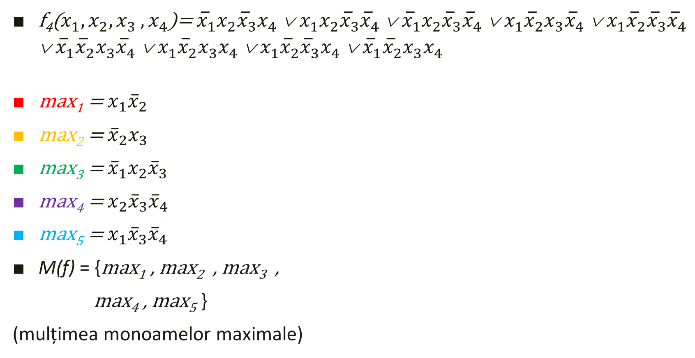
f₄($x_{1},x_{2}{,x}_{3}{,x}_{4}$)= ${\overline{x}}_{1}x_{2}{\overline{x}}_{3}x_{4}$ ∨ $x_{1}x_{2}{\overline{x}}_{3}{\overline{x}}_{4}$ ∨ ${\overline{x}}_{1}x_{2}{\overline{x}}_{3}{\overline{x}}_{4}$ ∨ $x_{1}{\overline{x}}_{2}x_{3}{\overline{x}}_{4}$ ∨ $x_{1}{\overline{x}}_{2}{\overline{x}}_{3}{\overline{x}}_{4}$ ∨ ${\overline{x}}_{1}{\overline{x}}_{2}x_{3}{\overline{x}}_{4}$ ∨ $x_{1}{\overline{x}}_{2}x_{3}x_{4}$ ∨ $x_{1}{\overline{x}}_{2}{\overline{x}}_{3}x_{4}$ ∨ ${\overline{x}}_{1}{\overline{x}}_{2}x_{3}x_{4}$
max₁ = $x_{1}{\overline{x}}_{2}$
max₂ = ${\overline{x}}_{2}x_{3}$
max₃ = ${\overline{x}}_{1}x_{2}{\overline{x}}_{3}$
max₄ =${ x}_{2}{\overline{x}}_{3}{\overline{x}}_{4}$
max₅ = $x_{1}{\overline{x}}_{3}{\overline{x}}_{4}$
M(f) = {max₁ , max₂ , max₃ ,
max₄ , max₅ }
(mulțimea monoamelor maximale)
m₅
m₁₂
m₄
m₁₀
m₈
m₂
m₁₁
m₉
m₃

Slide 29

f₄($x_{1},x_{2}{,x}_{3}{,x}_{4}$)= ${\overline{x}}_{1}x_{2}{\overline{x}}_{3}x_{4}$ ∨ $x_{1}x_{2}{\overline{x}}_{3}{\overline{x}}_{4}$ ∨ ${\overline{x}}_{1}x_{2}{\overline{x}}_{3}{\overline{x}}_{4}$ ∨ $x_{1}{\overline{x}}_{2}x_{3}{\overline{x}}_{4}$ ∨ $x_{1}{\overline{x}}_{2}{\overline{x}}_{3}{\overline{x}}_{4}$ ∨ ${\overline{x}}_{1}{\overline{x}}_{2}x_{3}{\overline{x}}_{4}$ ∨ $x_{1}{\overline{x}}_{2}x_{3}x_{4}$ ∨ $x_{1}{\overline{x}}_{2}{\overline{x}}_{3}x_{4}$ ∨ ${\overline{x}}_{1}{\overline{x}}_{2}x_{3}x_{4}$
max₁ = $x_{1}{\overline{x}}_{2}$
max₂ = ${\overline{x}}_{2}x_{3}$
max₃ = ${\overline{x}}_{1}x_{2}{\overline{x}}_{3}$
max₄ = $x_{2}{\overline{x}}_{3}{\overline{x}}_{4}$
max₅ = $x_{1}{\overline{x}}_{3}{\overline{x}}_{4}$
C(f) = {max₁ , max₂ , max₃}
(mulțimea monoamelor centrale)
m₅
m₁₂
m₄
m₁₀
m₈
m₂
m₁₁
m₉
m₃

Slide 30

f₄($x_{1},x_{2}{,x}_{3}{,x}_{4}$)= ${\overline{x}}_{1}x_{2}{\overline{x}}_{3}x_{4}$ ∨ $x_{1}x_{2}{\overline{x}}_{3}{\overline{x}}_{4}$ ∨ ${\overline{x}}_{1}x_{2}{\overline{x}}_{3}{\overline{x}}_{4}$ ∨ $x_{1}{\overline{x}}_{2}x_{3}{\overline{x}}_{4}$ ∨ $x_{1}{\overline{x}}_{2}{\overline{x}}_{3}{\overline{x}}_{4}$ ∨ ${\overline{x}}_{1}{\overline{x}}_{2}x_{3}{\overline{x}}_{4}$ ∨ $x_{1}{\overline{x}}_{2}x_{3}x_{4}$ ∨ $x_{1}{\overline{x}}_{2}{\overline{x}}_{3}x_{4}$ ∨ ${\overline{x}}_{1}{\overline{x}}_{2}x_{3}x_{4}$
M(f) $≠$ C(f) , C(f) $≠∅$
cazul 2 al algoritmului de
simplificare
Notăm:
g ($x_{1}{,x}_{2},$ $x_{3}{,x}_{4}$) = max₁ ∨ max₂ ∨ max₃
h₁ ($x_{1}{,x}_{2},$ $x_{3}{,x}_{4}$) = max₄
h₂ ($x_{1}{,x}_{2},$ $x_{3}{,x}_{4}$) = max₅
m₅
m₁₂
m₄
not.
m₁₀
m₈
m₂
not.
m₁₁
m₉
m₃

Slide 31

f₄($x_{1},x_{2}{,x}_{3}{,x}_{4}$)= ${\overline{x}}_{1}x_{2}{\overline{x}}_{3}x_{4}$ ∨ $x_{1}x_{2}{\overline{x}}_{3}{\overline{x}}_{4}$ ∨ ${\overline{x}}_{1}x_{2}{\overline{x}}_{3}{\overline{x}}_{4}$ ∨ $x_{1}{\overline{x}}_{2}x_{3}{\overline{x}}_{4}$ ∨ $x_{1}{\overline{x}}_{2}{\overline{x}}_{3}{\overline{x}}_{4}$ ∨ ${\overline{x}}_{1}{\overline{x}}_{2}x_{3}{\overline{x}}_{4}$ ∨ $x_{1}{\overline{x}}_{2}x_{3}x_{4}$ ∨ $x_{1}{\overline{x}}_{2}{\overline{x}}_{3}x_{4}$ ∨ ${\overline{x}}_{1}{\overline{x}}_{2}x_{3}x_{4}$
f₄’₁ ($x_{1}{,x}_{2},$ $x_{3}{,x}_{4}$) = g ∨ h₁
= max₁ ∨ max₂ ∨ max₃ ∨ max₄
= $x_{1}{\overline{x}}_{2}$∨ ${\overline{x}}_{2}x_{3}\text{∨} {\overline{x}}_{1}x_{2}{\overline{x}}_{3}$∨ $x_{2}{\overline{x}}_{3}{\overline{x}}_{4}$
f₄’₂ ($x_{1}{,x}_{2},$ $x_{3}{,x}_{4}$) = g ∨ h₂
= max₁ ∨ max₂ ∨ max₃ ∨ max₅
= $x_{1}{\overline{x}}_{2}$∨${ \overline{x}}_{2}x_{3}\text{∨} {\overline{x}}_{1}x_{2}{\overline{x}}_{3}$∨ $x_{1}{\overline{x}}_{3}{\overline{x}}_{4}$
Formele simplificate ale funcției f₄ :
m₅
m₁₂
m₄
m₁₀
m₈
m₂
m₁₁
m₉
m₃

